Slide 1
Agile Development
Tanner Hunt
CS250 Software Development Lifecycle
Feb 14, 2025

Slide 2
Agile Roles
3 main roles:
Developer
Broad term that includes (West, 2025):
Designers
Writers
Programmers
testers
Product Owner (West, 2025)
Sets the direction for development
Gathers requirements from stakeholders
Scrum Master (West, 2025)
Facilitates Scrum events
Keeps the team on track

Slide 3
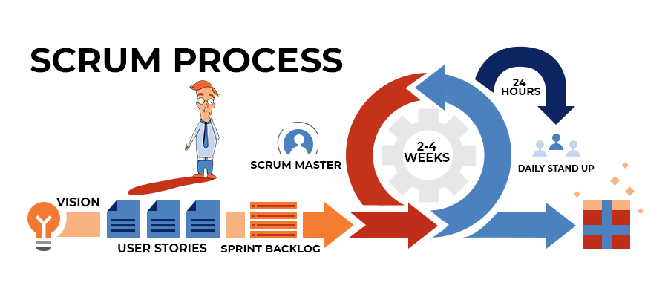
Agile Phases
Release cycles are broken into 1–4-week blocks
Planning phase (Žáček et al. 2025)
Requirements are gathered
Realistic goals are set
Development
Testing and development done together
Daily standup meetings addresses development speed and hurdles
Release
Sprint retrospective for process improvement
New sprint is started for next features
Acceptance is gauged by the wider audience
Image credit: Ahmed Suleiman, Linkedin

Slide 4
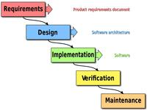
Waterfall Model
The waterfall method follows sequential development steps
If this were a waterfall project:
The requirements would be gathered and set at the start of development
Team meetings likely would not include an interdisciplinary team
The project would not easily pivot to focusing on health and wellness vacations
Testing would not start until the end of development (Lasky, 2025)
The project would only be released after final testing (Lasky, 2025)
Image credit Peter Kemp/ Paul Smith via Wikimedia Commons

Slide 5
Waterfall vs. Agile
Waterfall
More up front planning (Sinha & Das, 2021)
Easier Budgeting (Sinha & Das, 2021)
Lots of documentation (Cobb, 2015)
Errors may not be caught until late in development
Team may be divided into departments with little communication (Cobb, 2015)
Agile
Less up front planning (Cobb, 2015)
Embraces uncertainty
Smaller teams
Highly adaptable (Sinha & Das, 2021)
Highly collaborative team environment (Cobb, 2015)
Overall, Agile development is more appropriate when the project calls for adaptability.
Agile was appropriate for this project because the websites design could change at any
time. The waterfall method is appropriate when the project calls for more upfront planning
And is unlikely to change. Most projects will not be strictly agile or strictly waterfall, but
Be something in between (Cobb, 2015).

Slide 6
References
Cobb, C. (2015). The Project Manager's Guide to Mastering Agile : Principles and Practices for an Adaptive Approach. Wiley. Retrieved from https://research.ebsco.com/c/xp4pnu/search/details/tbfxle5mbr?db=nlebk
Lasky, J. (2025). Software Development. Retrieved from https://research.ebsco.com/c/ix3dnl/viewer/html/ypwki2eftr
Sinha, A., Das, P. (2021). Agile Methodology Vs. Traditional Waterfall SDLC: A Case Study on Quality Assurance Process in Software Industry. IEEE. DOI 10.1109/IEMENTech53263.2021.9614779
West, D. (2025). Agile Scrum Roles and Responsibilities. Atlassian. https://www.atlassian.com/agile/scrum/roles
Žáček, M., Hamplová, A., Tyrychtr, J., Vrana, I. (2025). Improvements for the Planning Process in the Scrum Method. MDPI. DOI https://doi.org/10.3390/app15010202

